Slide 1

Search Algorithms: Object-Oriented Implementation (Part A)
Search Algo. (= 탐색) is the foundation of AI algorithm!
In Machine Learning and Deep Learning problems, we perform optimization, and search techniques are used for this. From this lecture onward, we will study the theory of basic search algorithms and how to implement them using OOP.

Slide 2
Contents
Conventional vs. AI Algorithms
Local Search Algorithms
Implementing Hill-Climbing Algorithms
Defining ‘Problem’ Class
Adding Gradient Descent
Defining ‘HillClimbing’ Class
Adding More Algorithms and Classes
Experiments
This Part A cover the following topics

Slide 3
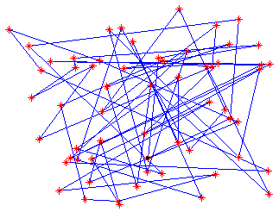
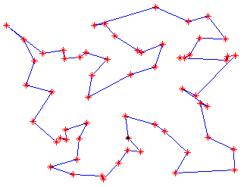

Conventional vs. AI Algorithms
Intractable problems (Problems that are difficult to handle in a mathematical sense...)
  There are many optimization problems (최적화 문제) that require a lot of time to solve, but no efficient algorithms have been identified
  Exponential (time complexity) algorithms are useless except for very small problems
Example. Traveling Salesperson Problem (외판원 문제)
  The salesperson wants to minimize the total traveling cost (예: 이동 시간/거리) required to visit all the cities in a territory, and return to the starting point
Visits n cities randomly without a plan
➔ Travel path is longer (= higher cost)
Optimal travel path

Slide 4
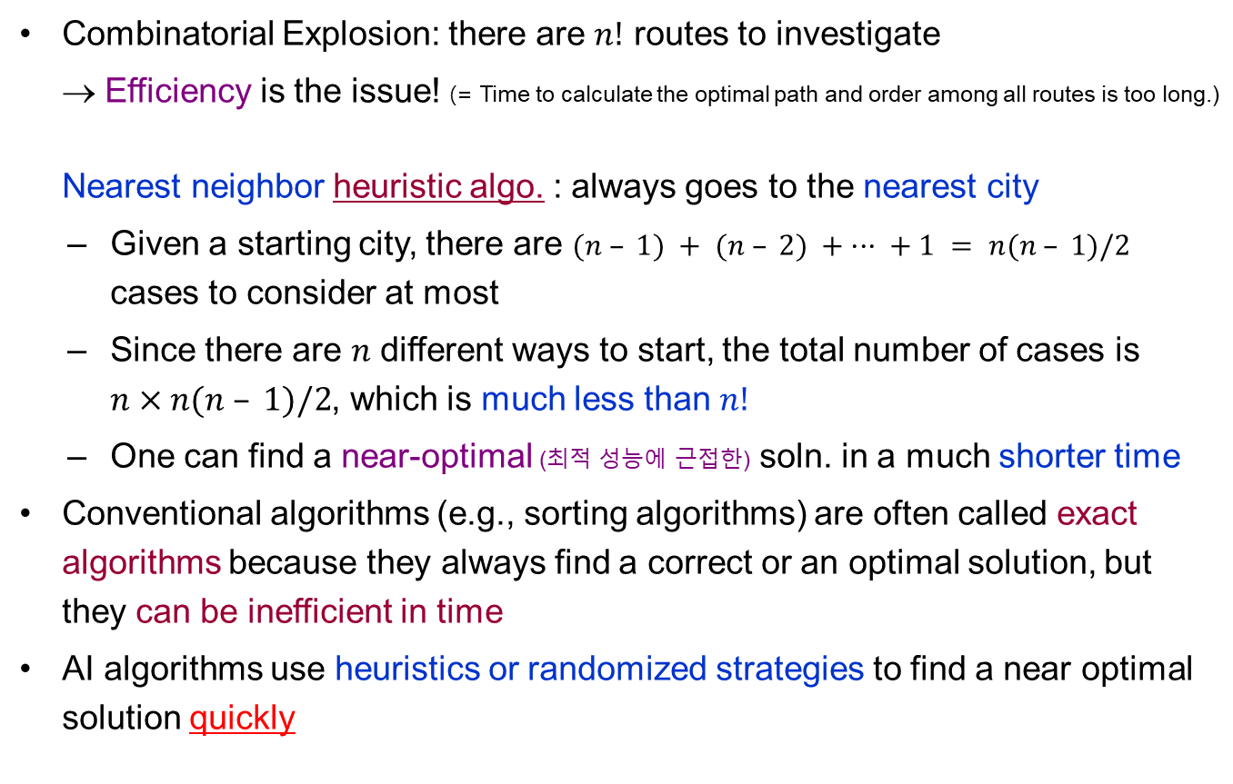
Conventional vs. AI Algorithms
Combinatorial Explosion: there are $n!$ routes to investigate
→ Efficiency is the issue! (= Time to calculate the optimal path and order among all routes is too long.)
Nearest neighbor heuristic algo. : always goes to the nearest city
  Given a starting city, there are $(n – 1) + (n – 2) + ··· + 1 = n(n – 1)/2$ cases to consider at most
  Since there are $n$ different ways to start, the total number of cases is
  $n×n(n – 1)/2$, which is much less than $n!$
  One can find a near-optimal (최적 성능에 근접한) soln. in a much shorter time
Conventional algorithms (e.g., sorting algorithms) are often called exact algorithms because they always find a correct or an optimal solution, but they can be inefficient in time
AI algorithms use heuristics or randomized strategies to find a near optimal solution quickly
Time-efficient algorithms designed to find an approximate solution
Starting from a city, visit the nearest among the remaining n-1 cities, then the nearest of n-2, and so on….

Slide 5
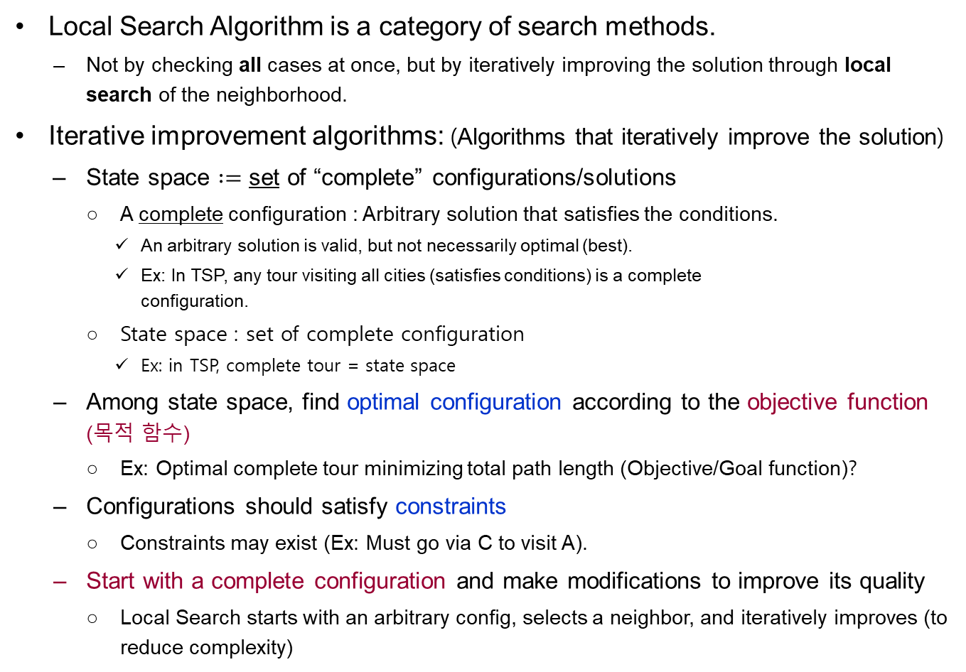
Local Search Algorithms
Local Search Algorithm is a category of search methods.
  Not by checking all cases at once, but by iteratively improving the solution through local search of the neighborhood.
Iterative improvement algorithms: (Algorithms that iteratively improve the solution)
  State space $:=$ set of “complete” configurations/solutions
    A complete configuration : Arbitrary solution that satisfies the conditions.
      An arbitrary solution is valid, but not necessarily optimal (best).
      Ex: In TSP, any tour visiting all cities (satisfies conditions) is a complete
      configuration.
    State space : set of complete configuration
      Ex: in TSP, complete tour = state space
  Among state space, find optimal configuration according to the objective function (목적 함수)
    Ex: Optimal complete tour minimizing total path length (Objective/Goal function)?
  Configurations should satisfy constraints
    Constraints may exist (Ex: Must go via C to visit A).
  Start with a complete configuration and make modifications to improve its quality
    Local Search starts with an arbitrary config, selects a neighbor, and iteratively improves (to reduce complexity)
CAUTION! Search aims for the optimal solution among many/infinite complete configurations. A "solution" is just a valid state, not necessarily the most optimal one.

Slide 6
Local Search Algorithms
Example: TSP (Visiting 5 cities, A-B-C-D-E)
  [Step 1] Current configuration: (Select an arbitrary complete tour and calculate cost.)
  [Step 2] Find a slightly different (neighbor) configuration, and if valid, select the one with the minimum cost.
    Candidate neighborhood configurations (of the current configuration):
B | A | C | E | D
B | E | C | A | D
Mutation by inversion: // One of the techniques for selecting candidates (neighbors)
A random subsequence is inverted (Select a random range and reverse the values within that range.)
Select the best complete tour among candidates and repeat the inversion process to gradually find a better tour.
B | A | E | C | D
E | C | A | B | D
B | A | C | D | E
Performance:
Variants of this approach get within 1% of optimal very quickly with thousands of cities
C | A | B | E | D

Slide 7
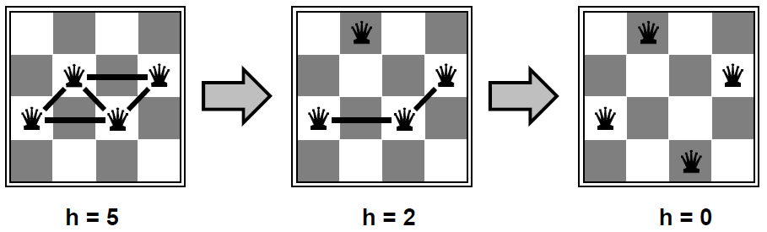
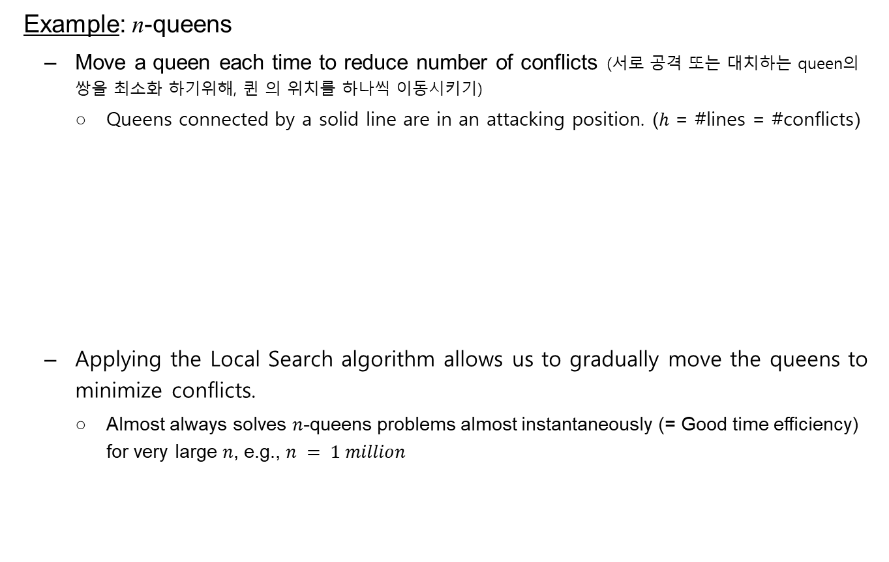
Local Search Algorithms
Example: n-queens
  Move a queen each time to reduce number of conflicts (서로 공격 또는 대치하는 queen의 쌍을 최소화 하기위해, 퀸 의 위치를 하나씩 이동시키기)
    Queens connected by a solid line are in an attacking position. ($h$ = #lines = #conflicts)
  Applying the Local Search algorithm allows us to gradually move the queens to minimize conflicts.
    Almost always solves $n$-queens problems almost instantaneously (= Good time efficiency) for very large $n$, e.g., $n = 1 million$

Slide 8
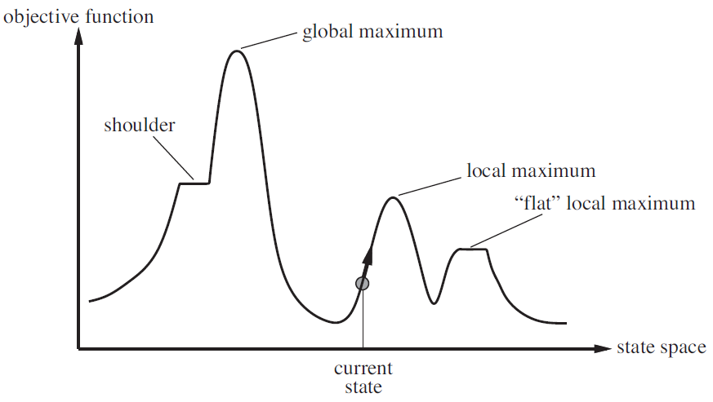
Local Search Algorithms
State space landscape (The overall shape of the state space distribution)
  x-axis: state (= configuration = solution)
  y-axis: objective function (OF) or cost function
  CAUTION! Local search generally reaches a local maximum, not the optimal global maximum, despite its best efforts.
CAUTION! A "solution" is just a valid state satisfying conditions. A problem can have many solutions, but finding the optimal one is key.
The best point (optimal) when all states are considered.
OF changes when the state changes (Ex: choosing a different TSP route), thus the OF value (total path length) changes.
CAUTION! OF value can be better when high (Ex: Maximize profit) or better when low (Ex: Minimized TSP distance).
The right figure is an example where a higher OF value is better.
The point that looks best when searched locally.
current state = current configuration = the best solution found so far.

Slide 9

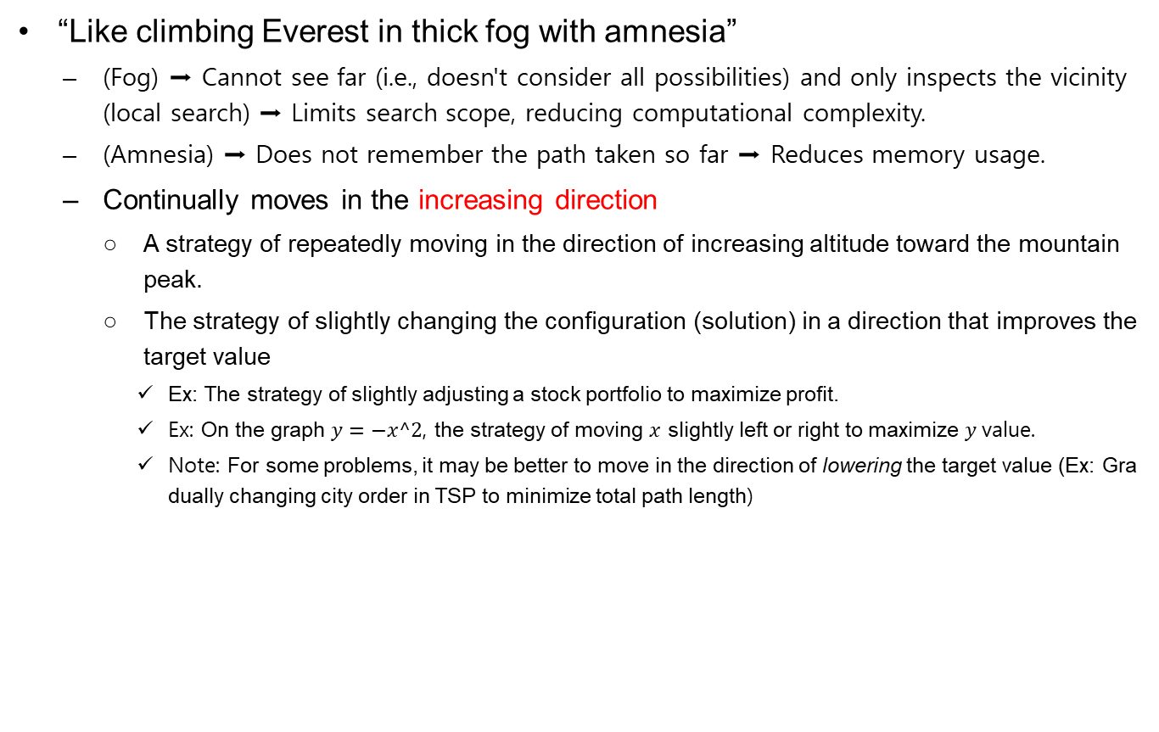
Hill-Climbing Search
“Like climbing Everest in thick fog with amnesia”
  (Fog) ➡ Cannot see far (i.e., doesn't consider all possibilities) and only inspects the vicinity (local search) ➡ Limits search scope, reducing computational complexity.
  (Amnesia) ➡ Does not remember the path taken so far ➡ Reduces memory usage.
  Continually moves in the increasing direction
    A strategy of repeatedly moving in the direction of increasing altitude toward the mountain peak.
    The strategy of slightly changing the configuration (solution) in a direction that improves the target value
      Ex: The strategy of slightly adjusting a stock portfolio to maximize profit.
      Ex: On the graph $y=−x^2$, the strategy of moving $x$ slightly left or right to maximize $y$value.
      Note: For some problems, it may be better to move in the direction of lowering the target value (Ex: Gradually changing city order in TSP to minimize total path length)

Slide 10
Hill-Climbing Search
“Like climbing Everest in thick fog with amnesia”
  Also called gradient ascent/descent search (in case of continuous space)
    Maximize value using ascent, minimize value using descent.
    However, for minimization problems, you can solve it as a maximization problem by setting the goal value = goal value * -1
[Steepest ascent version]
Details on next page...
1: function HILL-CLIMBING( problem ) returns a state that is a local maximum
2:
3: current ← MAKE-NODE(problem.INITIAL-STATE)
4: loop do
5: neighbor ← a highest-valued successor of current
6: if neighbor.VALUE ≤ current.VALUE then return current.STATE
7: else current ← neighbor

Slide 11
Hill-Climbing Search
“Like climbing Everest in thick fog with amnesia”
[Steepest ascent version]
1: function HILL-CLIMBING(problem) returns a state that is a local maximum
HILL-CLIMBING function that takes the problem as input (Ex: moving to the mountain peak) and returns
the best result (local maximum)
3: current ← MAKE-NODE(problem.INITIAL-STATE)
Uses the initial state as input (Ex: location of the trail entrance) to create the current state
(current position = an arbitrary solution)
4: loop do
Repeats until the best result(local max) is found
5: neighbor ← a highest-valued successor of current
Selects the highest-valued state among the neighbors (neighbor, successor) of the current state
(Ex: Select the highest elevation point among the spots immediately accessible from the trail entrance).
6: if neighbor.VALUE ≤ current.VALUE then return current.STATE
If the selected neighbor is not better than the current state (Ex: if elevation is lower), it assumes no
better solution exists and returns the current state.
7: else current ← neighbor
If the neighbor is better than the current state (Ex: elevation is higher), move to that point, save it as
current, and repeat the loop.
Among algorithms that gradually improve a solution, one solution must be given to begin improvement, so an initial solution is randomly selected.

Slide 12
Hill-Climbing Search
Example: Finding optimal locations for 3 airports in Romania
  state space: x,y coordinates of 3 candidate airport locations
  (x₁, y₁), (x₂, y₂), (x₃, y₃)
  Objective function:
  f (x₁, y₁, x₂, y₂, x₃, y₃) = Sum of distances from all cities to the nearest airport ➔ Minimize f (minimization problem)
  Hill-Climbing Search Method
    Randomly select initial locations for the 3 airports
    Slightly move airport locations to select candidate areas (= find neighbor/adjacent solutions) ➔ Check if objective function increases or decreases ➔ Repeat process of moving to better airport location

Slide 13
Hill-Climbing Search
Drawback: often gets stuck to local maxima due to greediness
  Moves to the seemingly best state by only considering nearby neighboring points (= greedy approach)
  Applying Hill-Climbing to the graph below, it immediately returns after reaching a local maximum (no better solutions nearby), failing to reach the actual optimal point (global maximum)

Slide 14
Hill-Climbing Search
Drawback: often gets stuck to local maxima due to greediness
Possible solutions (Ways to overcome the drawback of getting stuck at local max):
  key idea: Don't necessarily choose a point just because it looks good immediately!
  Stochastic hill climbing:
    Chooses at random among the uphill moves with probability proportional to steepness
    Assigns probability to each candidate state/solution proportional to its steepness (gradient), and selects one based on this probability.
  First-choice (simple) hill climbing:
    Generates successors randomly until one is found that is better than the current state
    Selects candidate states randomly and chooses the first one that is better than the current state (simple calculation)
  Random-restart hill climbing:
    Conducts a series of hill-climbing searches from randomly generated initial states
    Repeats hill-climbing multiple times by varying the starting point (initial state), and selects the best solution among them
  Note: Even using the above techniques may not guaranteed to find the global maximum.

Slide 15
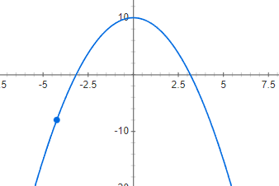
Hill-Climbing Search
Complexity (시간 복잡도, time complexity):
  A standard for evaluating the time required to execute an algorithm (specifically, counting the number of basic operations needed to complete the algorithm)
  The success of hill climbing depends on the shape of the state-space landscape
  NP-hard problems typically have an exponential number of local maxima to get stuck on
  A reasonably good local maximum can often be found after a small number of restarts with different starting point
Note: The concept of space complexity is also present
Since the final result may vary depending on the randomly selected initial state, calculate optimal solutions for various starting points and select the best one among them
Reason why Local search techniques are widely used
It's difficult to find the optimal solution because the state space landscape is complex (non-convex)
Optimal solution can be found quickly because the state space landscape is simple (Convex)
Convex vs Non-Convex

Slide 16
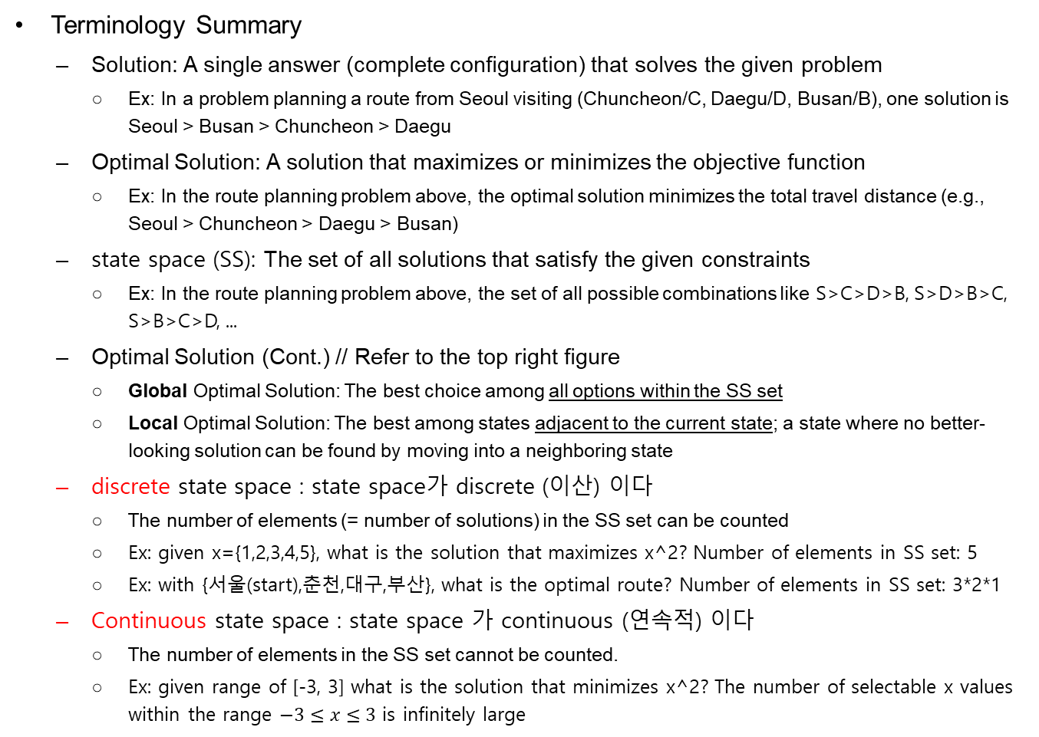
Continuous State Spaces
연속 상태 공간
Terminology Summary
  Solution: A single answer (complete configuration) that solves the given problem
    Ex: In a problem planning a route from Seoul visiting (Chuncheon/C, Daegu/D, Busan/B), one solution is Seoul > Busan > Chuncheon > Daegu
  Optimal Solution: A solution that maximizes or minimizes the objective function
    Ex: In the route planning problem above, the optimal solution minimizes the total travel distance (e.g., Seoul > Chuncheon > Daegu > Busan)
  state space (SS): The set of all solutions that satisfy the given constraints
    Ex: In the route planning problem above, the set of all possible combinations like S>C>D>B, S>D>B>C, S>B>C>D, ...
  Optimal Solution (Cont.) // Refer to the top right figure
    Global Optimal Solution: The best choice among all options within the SS set
    Local Optimal Solution: The best among states adjacent to the current state; a state where no better-looking solution can be found by moving into a neighboring state
  discrete state space : state space가 discrete (이산) 이다
    The number of elements (= number of solutions) in the SS set can be counted
    Ex: given x={1,2,3,4,5}, what is the solution that maximizes x^2? Number of elements in SS set: 5
    Ex: with {서울(start),춘천,대구,부산}, what is the optimal route? Number of elements in SS set: 3*2*1
  Continuous state space : state space 가 continuous (연속적) 이다
    The number of elements in the SS set cannot be counted.
    Ex: given range of [-3, 3] what is the solution that minimizes x^2? The number of selectable x values within the range $−3≤x≤3$ is infinitely large

Slide 17
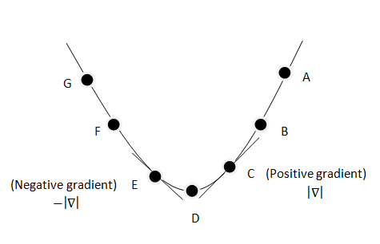
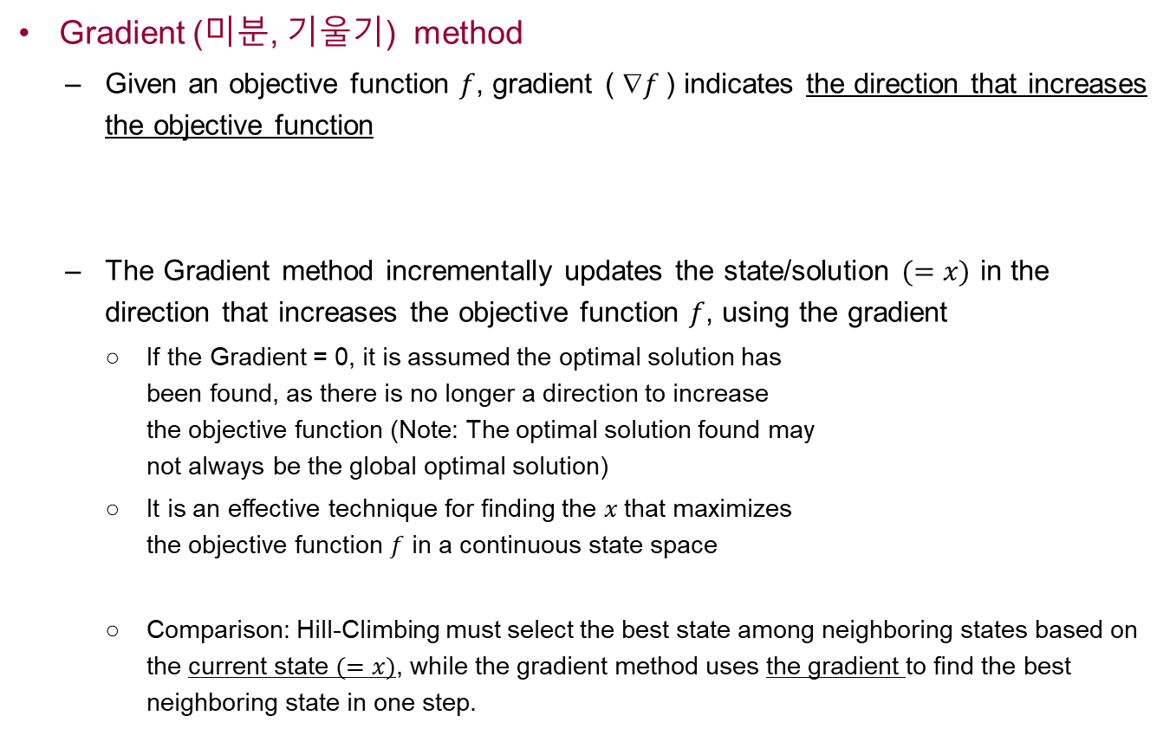

Continuous State Spaces & Gradient Method
Gradient (미분, 기울기) method
  Given an objective function $f$, gradient ( $f$) indicates the direction that increases the objective function
  The Gradient method incrementally updates the state/solution $(=x)$ in the direction that increases the objective function $f$, using the gradient
    If the Gradient = 0, it is assumed the optimal solution has
    been found, as there is no longer a direction to increase
    the objective function (Note: The optimal solution found may
    not always be the global optimal solution)
    It is an effective technique for finding the $x$that maximizes
    the objective function $f$ in a continuous state space
    Comparison: Hill-Climbing must select the best state among neighboring states based on the current state $(=x)$, while the gradient method uses the gradient to find the best neighboring state in one step.
$$\frac{dy}{dx}=\lim_{h→0}{\frac{f\left(x+h\right)−f\left(x\right)}{h}}$$

Slide 18
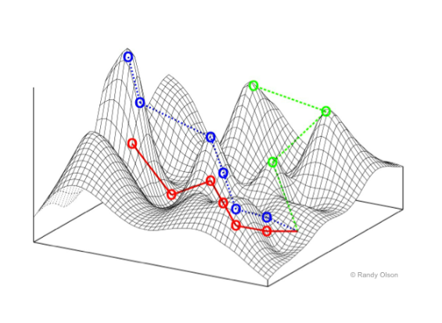
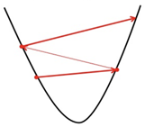

Continuous State Spaces & Gradient Method
Gradient (미분, 기울기) methods attempt to use the gradient of the landscape to maximize/minimize f by the following update rule:
x ← x +/– α ∇f(x) (α : update rate)
where ∇f (x) is the gradient vector (containing
all of the partial derivatives) of f that gives the
magnitude and direction of the steepest slope
In this case, α (step=size) must be chosen carefully
  Too small α : too many steps are needed
  Too large α : the search could overshoot the target
  Points where ∇f (x) = 0 are known as critical points
Rule for incrementally updating state$x$
state space landscape example
x, y axis : state space,
Z axis: Objective function magnitude
If reached, no better state can be found nearby
Overshoot

Slide 19
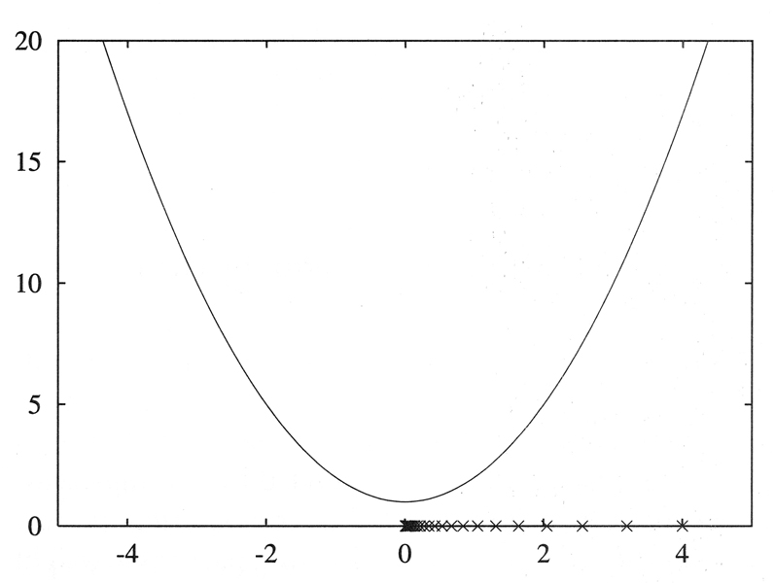


Continuous State Spaces & Gradient Method
Example: Gradient descent (Goal is to minimize the objective function)
  If $f(x) = x^{2}+1$, then $f’(x)=2x$
  Starting from an initial value $w=4$, with the step size of $0.1$:
    $4 –(0.124)=3.2$
    $3.2 –(0.123.2)=2.56$
    $2.56 –(0.122.56)=2.048$
    ⋅ ⋅ ⋅ ⋅ ⋅ ⋅
  Stops when the change in parameter
  value becomes too small
    Ex: stop if $\left|x\left[t+1\right]−x\left[t\right]\right|≤1e−5$
    or, stop if $\left|f ′\left(x\left[t\right]\right)\right|≤1e−5$
“To minimize”, update the state in the negative (-) direction
$$x[t+1]=x[t]– f (x[t])$$
state x update rule
Because reaching the Critical point exactly is probabilistically almost impossible

Slide 20
Simulated Annealing Search
Idea:
  Hill-Climbing/Gradient method examines the surroundings and makes the best choice from them (i.e., makes a locally optimal choice)
    HC : Selects the best state among neighboring states
    Grad. : Calculates the derivative (gradient) based on the current position, and moves in that direction to select a new state
    Both techniques stop when there is no better state
  However, if the starting position is poor, it may reach and terminate at a local optimal solution.
  Furthermore, always moving in the seemingly best direction after only checking the vicinity may be a poor decision

Slide 21
Simulated Annealing Search
Idea:
  Efficiency of valley-descending + completeness of random walk
    That is, select a better next state in a time-efficient manner, but add a "random" selection process when choosing the next state
  Escape local minima by allowing some “bad” moves. But gradually decrease their step size and frequency
    Randomly allows bad moves, which helps to find better solutions
    However, bad moves should be performed restrictively (i.e., gradually reduce the frequency of bad moves and the extent to which they change the state)

Slide 22
Simulated Annealing Search
Origin of the Algorithm's Name (annealing: metal tempering/heat treatment)
  Originates from the method of heating a metal material and then slowly cooling it (changing the temperature) to eliminate internal defects and encourage optimal physical properties (i.e., cool quickly at first, then slowly later to achieve stable properties!)
    Devised by Metropolis et al., 1953, for physical process modeling
    Widely used in VLSI layout, airline scheduling, etc.
  At fixed temperature T, state occupation probability reaches Boltzman distribution p(x) = α e^{–E(x) / kT}
  T decreased slowly enough → always reach the best state

Slide 23
Simulated Annealing Search
[Temperature change schedule] Passed as input, a schedule that changes the temperature from high to low (close to 0). It's stored as a list of what the temperature will be at each time-step.
function SIMULATED-ANNEALING(problem, schedule) returns a solution state
inputs: problem, a problem
schedule, a mapping from time to “temperature”
current ← MAKE-NODE(problem.INITIAL-STATE)
for t ← 1 to ∞ do
T ← schedule[t]
if T = 0 then return current
next ← a randomly selected successor of current
ΔE ← next.VALUE − current.VALUE
if ΔE < 0 then current ← next
else current ← next only with probability e^{–ΔE/T}
Calculate the current state from the initial state
Randomly select the next state
Calculate the difference in objective function between the two states (= energy difference)
Assumes a minimization problem ➔ Lower value is better
Selects a bad state probabilistically. Here, the probability varies based on the difference between the two solutions and the temperature (T)

Slide 24
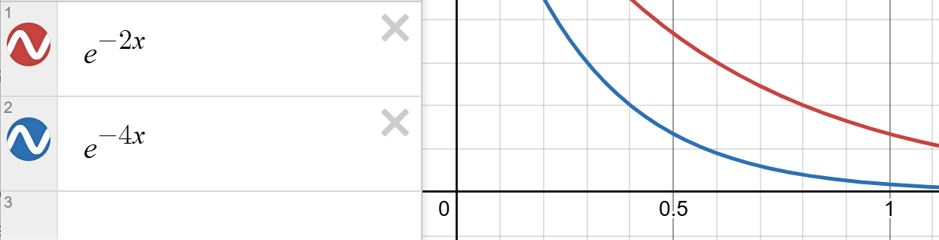
Simulated Annealing Search
A random move is picked (with decreasing probability) instead of the best move
If the move improves the situation, it is always accepted
Otherwise, the move is accepted with probability e ^{– ΔE / T}
  ΔE : the amount by which the evaluation is worsened
    The acceptance probability decreases exponentially with the “badness” of the move
    i.e., The worse the next state is, the lower the probability of selecting it.
  T : temperature, determined by the annealing schedule (controls the randomness)
    Bad moves are more likely at the start when T is high
      When the initial T value is high, the probability of accepting a random bad move is high.
    They become less likely as T decreases
      Since it's common to set the schedule so that T decreases as the iteration progresses, the probability of selecting a bad move decreases with each iteration.
  In short, random moves are highly permitted in the early stages, and restricted in the later stages

Slide 25
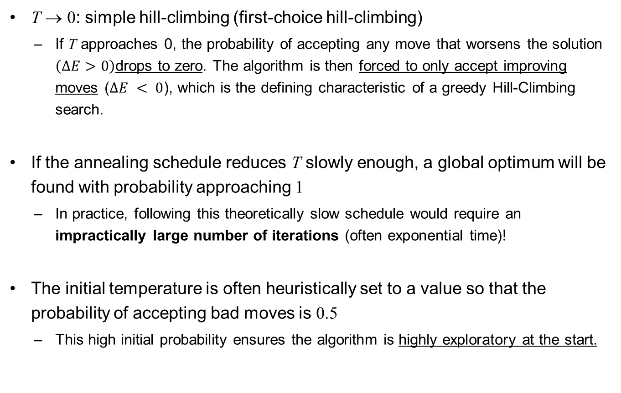
Simulated Annealing Search
T → 0: simple hill-climbing (first-choice hill-climbing)
  If T approaches 0, the probability of accepting any move that worsens the solution $\left(ΔE>0\right)$drops to zero. The algorithm is then forced to only accept improving moves ($ΔE < 0$), which is the defining characteristic of a greedy Hill-Climbing search.
If the annealing schedule reduces T slowly enough, a global optimum will be found with probability approaching 1
  In practice, following this theoretically slow schedule would require an impractically large number of iterations (often exponential time)!
The initial temperature is often heuristically set to a value so that the probability of accepting bad moves is 0.5
  This high initial probability ensures the algorithm is highly exploratory at the start.

